Slide 1

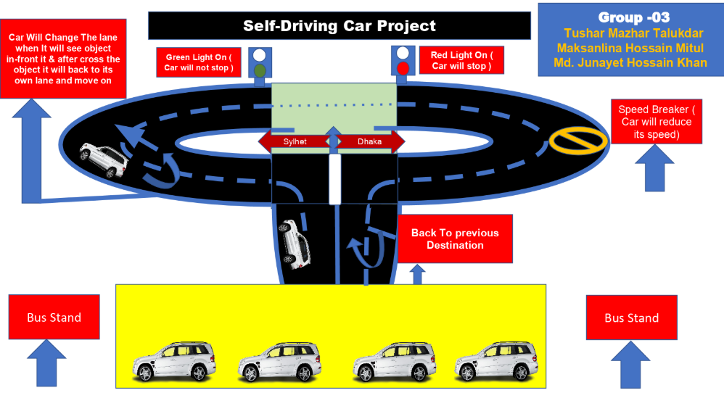
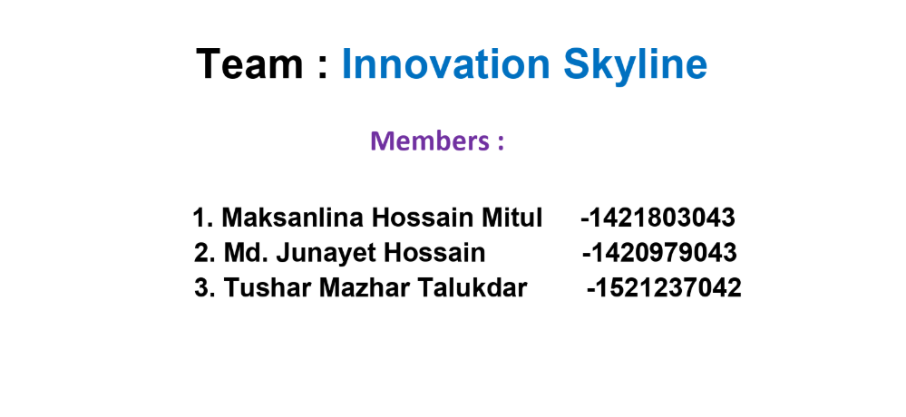

Slide 2
1. Our Project Goal/Problem
Our goal/problem for this project is to build a self driving car which will be able to function without human driver and run into roads by reading traffic lights,road signs ,detecting lane and other vehicles and pedestrians/objects.
This Project concept can be used:
1. Product transportation
2. Old people who are not capable of drive
3. This concept also can be used for making wheelchair, that will
help the patients and many more……….
Problem Faced :
We faced problems while giving proper connection between Arduino uno and L298h drive and the power supply.
As the connection between pins of Arduino uno and drive L298h is very significant as it activates the dc motors and the orientations of the wheels. The speed of the wheels were very slow.
Some of our components were faulty so we needed to find out and replace those components

Slide 3
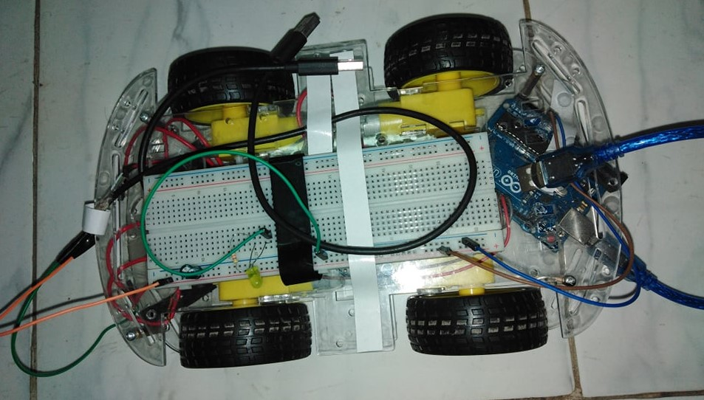
2. Project progress Percentage
We have done 40-45% of the total project

Slide 4
3. We have implemented some features within the term break. These features are --
We have built the Complete Physical Car
We have made the complete physical road
Our car can detect traffic lights and perform the exact task
Our car able to maintain the road lane

Slide 5
4. Our Next Two Month Plan We have done some features that are mentioned earlier slides, but some features did not implement yet. These are ---
Date | Task | Description
10th Feb-18th Feb | It will detect Road Breaker and perform the exact task | 1. Collect road breaker data( images) 2. We will train with these data
19th -29th Feb | It will detect object and change Road Lane if any need | 1 Object data train and we will apply deep learning method
1st March -24th March | Report Writing + Poster Design | [will be completed ]
25th March -4th April | Final project Test and Bug fixed Preparing for project Show-Case

Slide 6
5. Our Report Writing Plan
Reports generally involve presenting -
1. The investigation
2. Analysis of information or an issue,
3. Recommending actions and making proposals.
How we will prepare our report ,steps are given below-
Step-1: Decide on the "Terms of reference"
Step-2: Decide on the procedure
Step-3: Find the Information
Step-4: Decide on the structure
Step-5: Draft the first part of our report
Step-6: Analyze our findings and draw conclusions
Step-7: Recommendations making
Step-8: Draft the executive summary and table of contents
Step-9: Compile a reference list
Step-10: Revise our draft report and submit

Slide 7
6. Plan for capstone project show
There will be the show case of how the autonomous car runs.
The features can be shown through laptop’s simulator.
There will be a poster based on our project topic and theme.
We will be explaining to the teachers and guests what the project concept is and its operation.

Slide 8
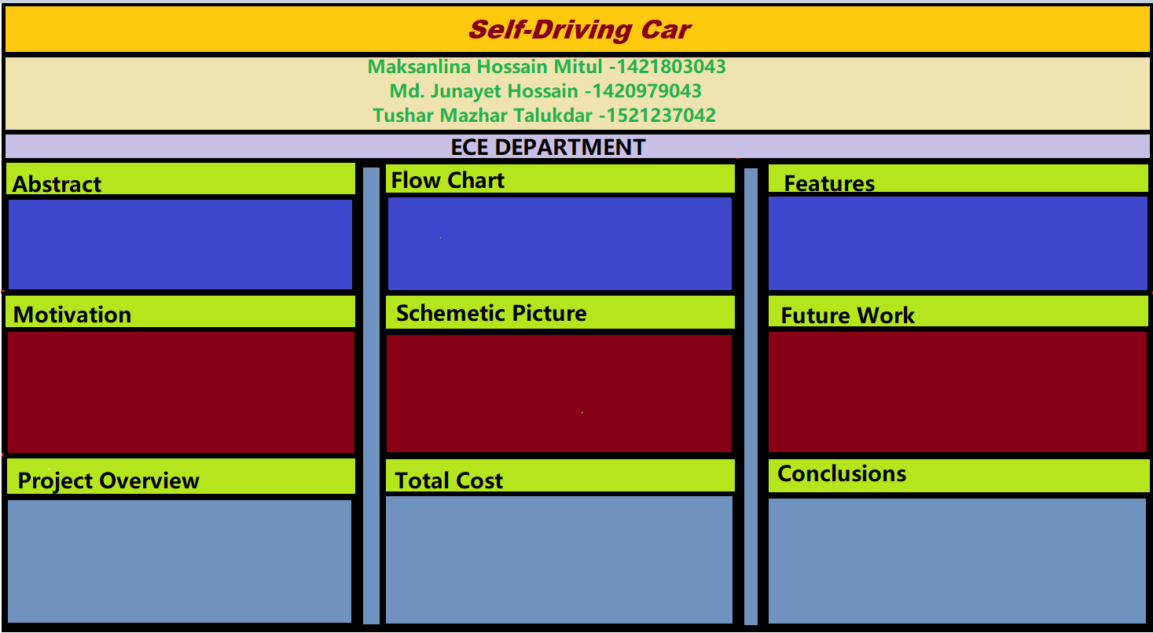
7. Yes, we are Ready to make the Poster We have created a basic poster layout- we will modify it by the time :-

Slide 9
8. Reasons for publishing our work
Our project concept is to build an autonomous car which is now a days very familiar in all over the world but it isn’t well introduced in our country.
Our aim is to make the self driving car suitable for product transportation in industrial areas within a limited area.
In industrial areas this kind of car will be very useful and safe for large and heavy transportations.
Many industries use chemicals for production that can be harmful for humans, in that case, this kind of car can be very useful inside those sites.
Also our aim is to make this car helpful for disable people. In our country there is very little opportunity in roads for disable people.
This makes our paper significant that our paper is focused to make an autonomous car which can be used in product transportation for industrial purpose and available for disable people in our country.

Slide 10
9. Most interesting/challenging part of our project
Our project has a interesting part
That is - Our car will change the lane when it will see any object in-front of it and after crossing the object it will back to its own lane and move on.

